Slide 1
Autoencoders

Slide 2
Contents
How do Neural Networks work
What are Auto Encoders
Applications of Auto Encoders
Different types of Auto Encoders

Slide 3
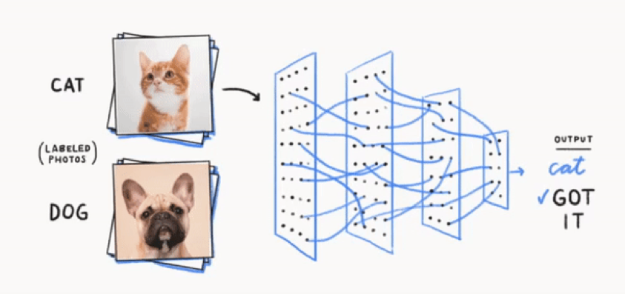
How do Neural Networks work
Neural Networks are functions which can map the inputs to outputs.
In this example, neural network can take in a photo and tell whether it is a cat or a dog.
Notes:
Original – Segmented – Actual Segmented – Difference

Slide 4
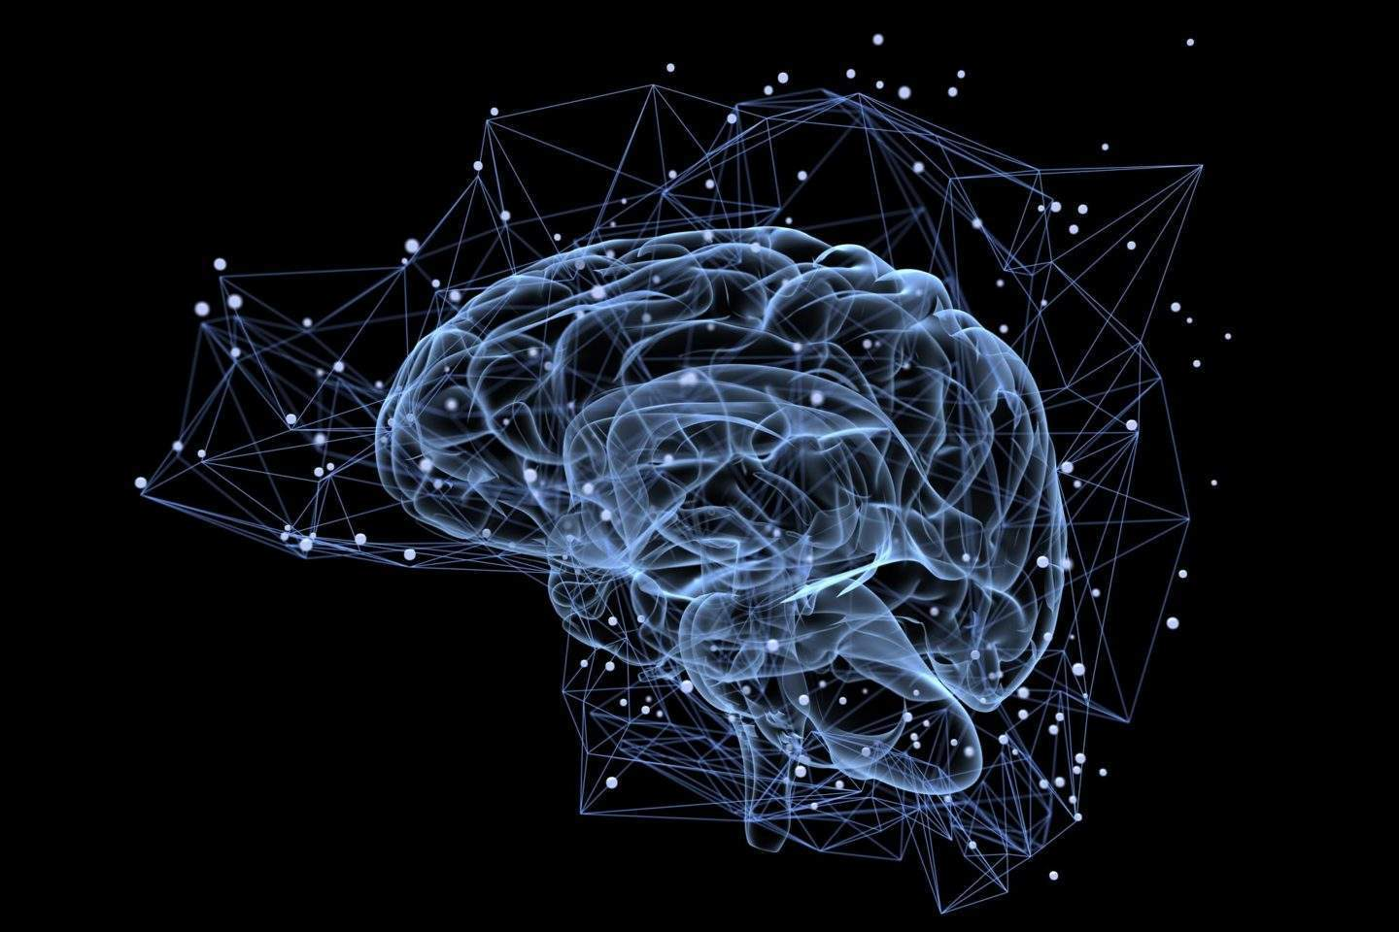
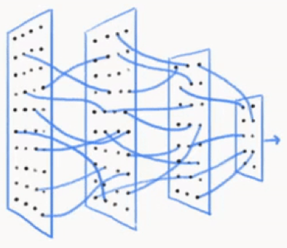
Neural Networks store information
Neural Network work similar to a human brain.
They store a small representation of the image of cat and dog and hence are able to classify.
This information is stored in the layers of the neural network.
Notes:
Original – Segmented – Actual Segmented – Difference

Slide 5
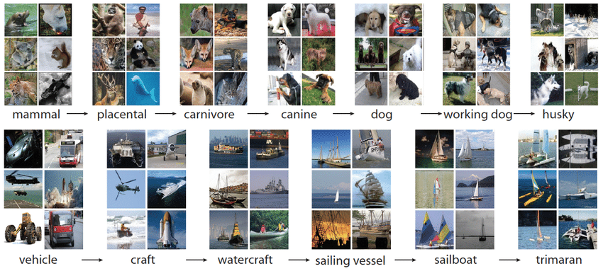
Neural Networks compress information
The neural network are trained on a lot of data and they store a very compressed mapping of this data.
This compressed representation of data is stored in the layers of the neural network.
Notes:
Original – Segmented – Actual Segmented – Difference

Slide 6
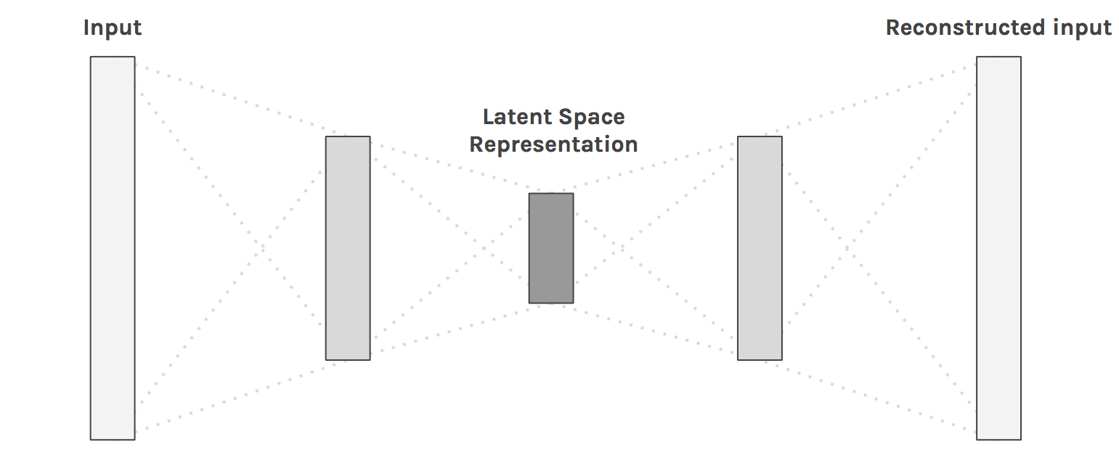
What are Autoencoders
Autoencoders is an unsupervised learning technique to learn the representation of data.
The auto in autoencoder means it will encode the data which it is fed.
This model will have the same data as input and output.
Autoencoder will learn a summary or compression of input also called as latent space representation.
Compressed representation
Notes:
Original – Segmented – Actual Segmented – Difference

Slide 7
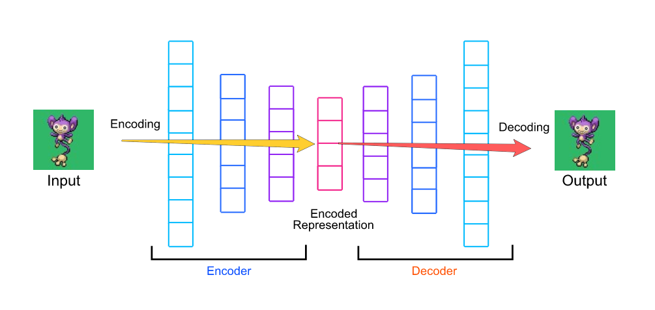
Components of Autoencoders
Autoencoders consist of 2 blocks:
Encoder
Decoder
Notes:
Original – Segmented – Actual Segmented – Difference

Slide 8
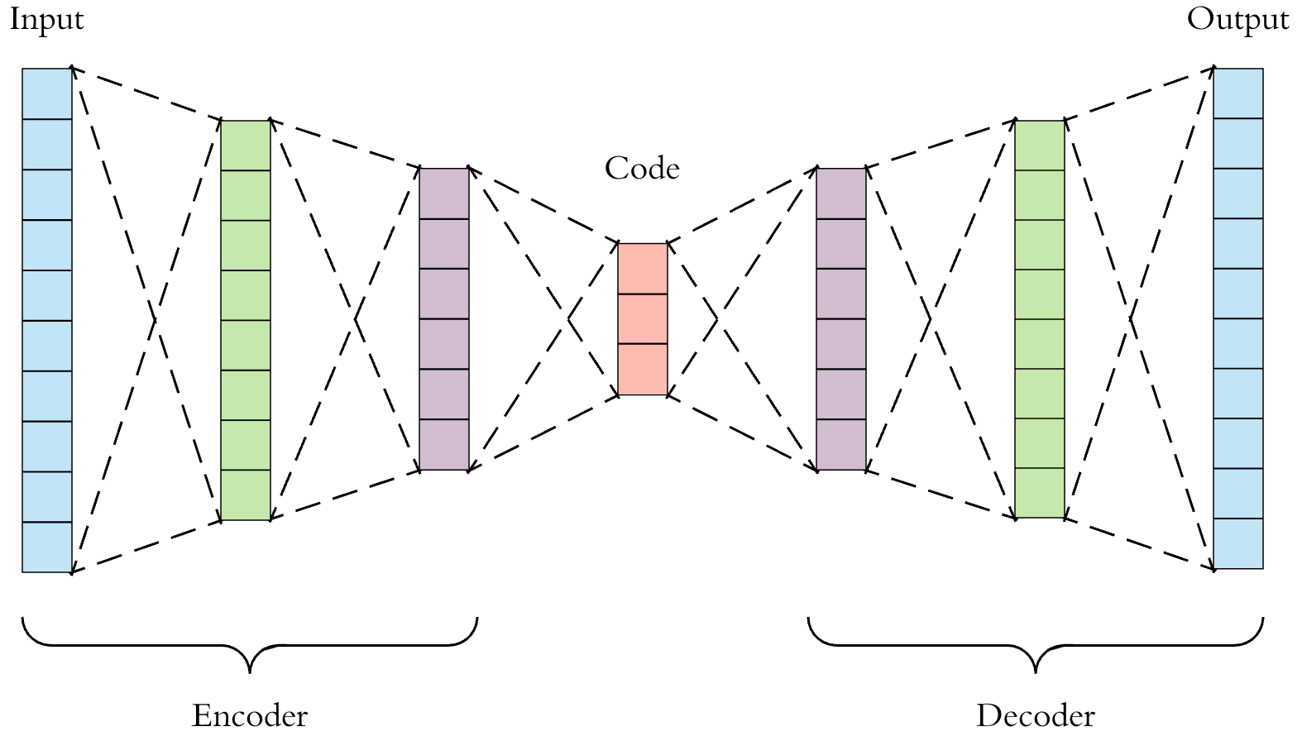
Components of Autoencoder
The encoder is a network which will compress the input data into a smaller representation.
The decoder is a network which will decompress the compressed data to generate the original input
Notes:
Original – Segmented – Actual Segmented – Difference

Slide 9
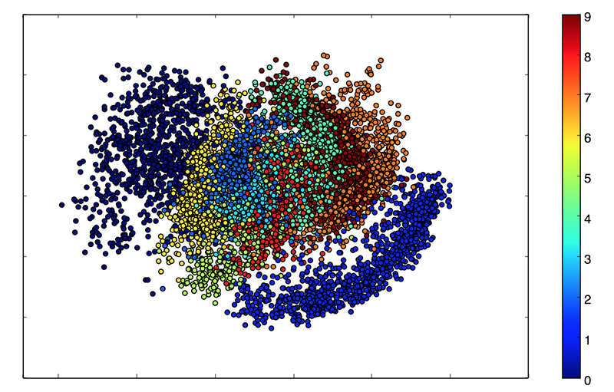
Autoencoders for Dimensionality Reduction
Autoencoders are generally used as a dimensionality reduction technique:
Data specific: Autoencoders are able to meaningfully compress data similar to what they are trained on.
Loss: Autoencoders store a compressed representation with some loss. This is why it is not as useful as a compression algorithm.
Unsupervised: Autoencoders do not need explicit labels. They are trained on input data and learn a compressed representation of the data.
This is latent space for hand written numbers.
Notes:
Original – Segmented – Actual Segmented – Difference

Slide 10
Applications of Autoencoders
Autoencoders are used for a variety of applications such as:
Image Denoising
Anomaly Detection
Image Generation
Encoder
Decoder
Autoencoder
Notes:
Original – Segmented – Actual Segmented – Difference

Slide 11
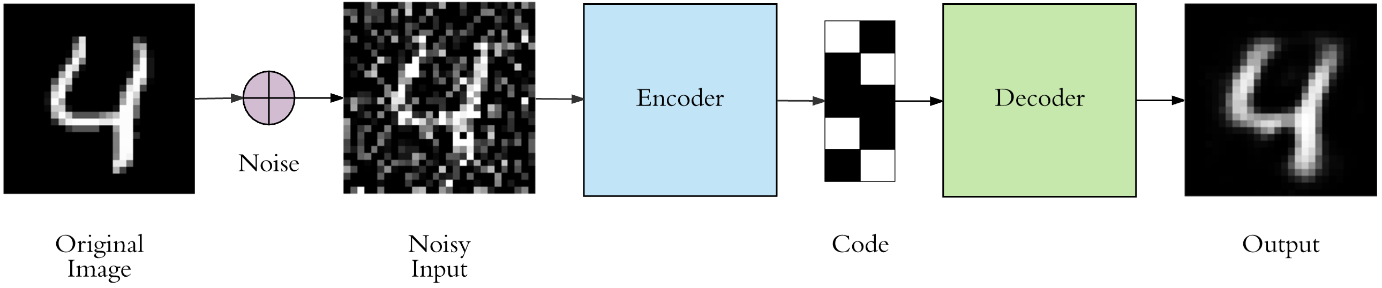
Image Denoising
Autoencoders can be used to remove and filter noise in images.
These are called Denoising autoencoders.
Notes:
Original – Segmented – Actual Segmented – Difference

Slide 12
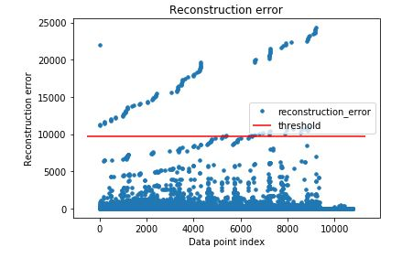
Anomaly Detection
Autoencoders can be used to find anomalies in the data.
The input data is passed through the autoencoder and we get a certain output.
We pass an unknown data and check the recontructed representation.
The difference between the reconstructed representation and the original representation is the reconstruction error.
If the error crosses a certain threshold, we call it an anomaly.
Notes:
Original – Segmented – Actual Segmented – Difference

Slide 13
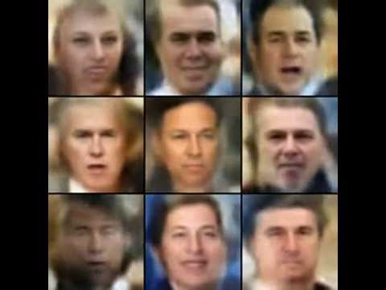
Image Generation
Autoencoders can be used to generate images.
In this example we can see how autoencoders can be used to entirely new human faces..
Notes:
Original – Segmented – Actual Segmented – Difference

Slide 14
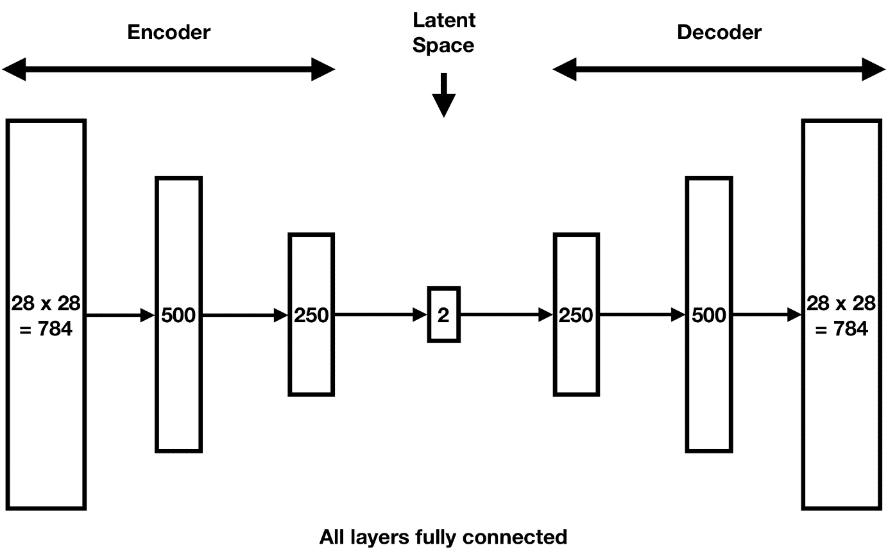
Architecture of Autoencoders
Autoencoder consists of 2 blocks, an encoder and a decoder.
The encoder and decoder are exactly the same i.e.
they have same number of layers,
Same number of neurons,
Same activation function
Here all layers are fully connected.
Notes:
Original – Segmented – Actual Segmented – Difference

Slide 15
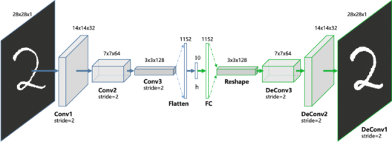
Convolutional Autoencoders
Autoencoders can also be build using convolutional neural networks.
Here all the encoders and decoders are convolutional layers.
The filter size and the depth of the layers should be same in the encoder and decoder.
For convolutional layers in the encoder, the decoder should have deconvolutional layers.
For max pooling layers in the encoder, the decoder should have upsampling layer.
This is mostly used for image data.
Notes:
Original – Segmented – Actual Segmented – Difference

Slide 16
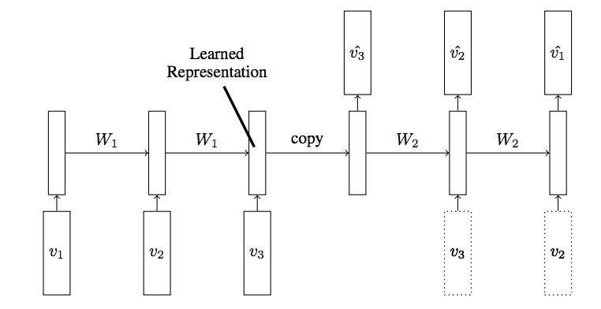
LSTM Autoencoders
LSTM Autoencoders can be used to deal with text, audio, sequence and time series data.
Notes:
Original – Segmented – Actual Segmented – Difference

Slide 17
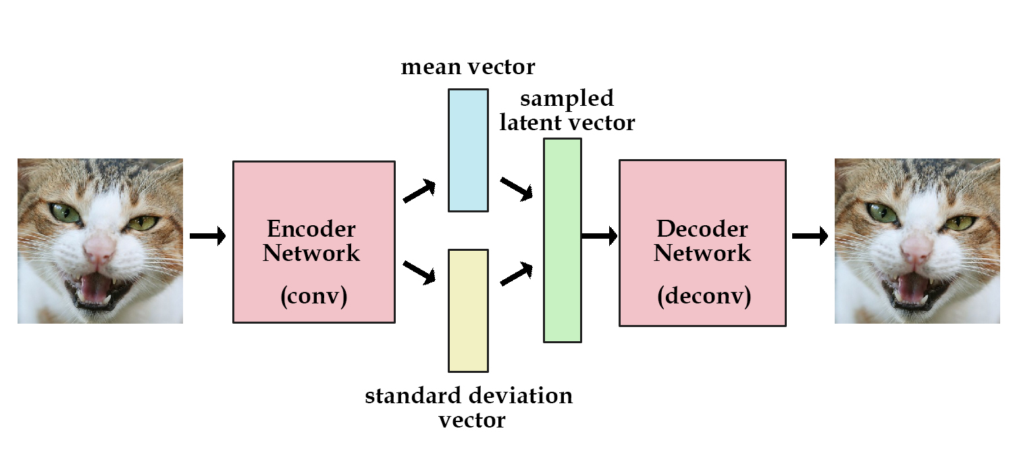
Variational Autoencoders
Variational Autoencoders are powerful generative models used for diverse applications such as generate fake human faces, generate music and so on.
Notes:
Original – Segmented – Actual Segmented – Difference

Slide 18
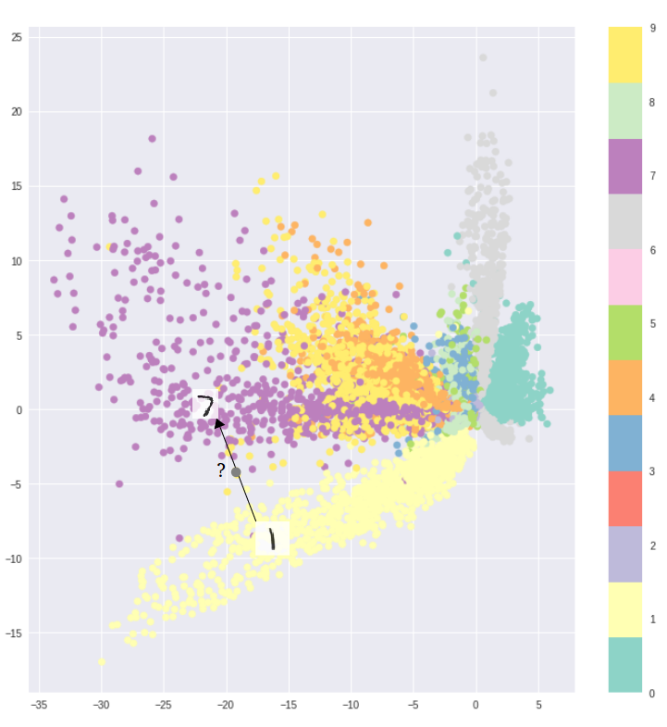
Problems with regular autoencoders
Standard autoencoders learn to generate compact representation of the inputs.
Here we can visualize a 2D latent space which has clusters of different hand written digits from MNIST dataset.
If we want to generate a new digit, we will have to sample from this latent space and pass it through the decoder to generate a new digit.
This is a problem because the latent space is not continuous and decoding from a random sample may not generate desired result.
We will need a continuous latent space for image generation.
Notes:
Original – Segmented – Actual Segmented – Difference

Slide 19
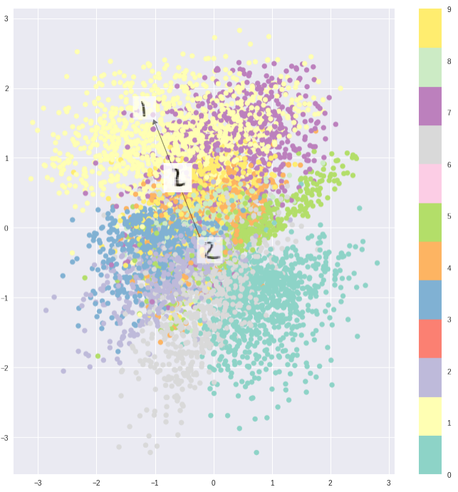
Variational Autoencoders
Variational Autoencoders have a unique property i.e. their latent space is continuous which make it easy for random sampling and generation.
Variational autoencoders are trained to minimize reconstruction loss and latent loss.
Latent loss is a measure to see whether the latent space is spread or continuous.
Notes:
Original – Segmented – Actual Segmented – Difference

Slide 20
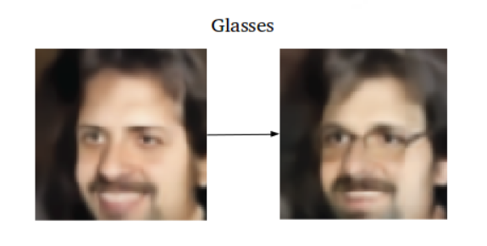
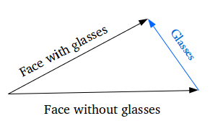
Adding specific features in VAE
If we want to generate a specific property such as a face with glasses this is how we should do:
Find a sample face with glasses and its encoding
Find a sample face without glasses and its encoding
The encoding of glasses is the difference between the two vectors
You can add this glass vector to any new face and decode it
Notes:
Original – Segmented – Actual Segmented – Difference

Slide 21
Difference between VAE and GANs
VAE
GAN
They generate blurry images.
Do not have stability issues.
Uses a single network of encoders and decoders and tries to minimize latent and reconstruction loss.
They generate good images using DCGANS.
Usually unstable and need proper tuning.
Uses two networks of generator and discriminator and plays a minmax game.
Notes:
Original – Segmented – Actual Segmented – Difference

Slide 22
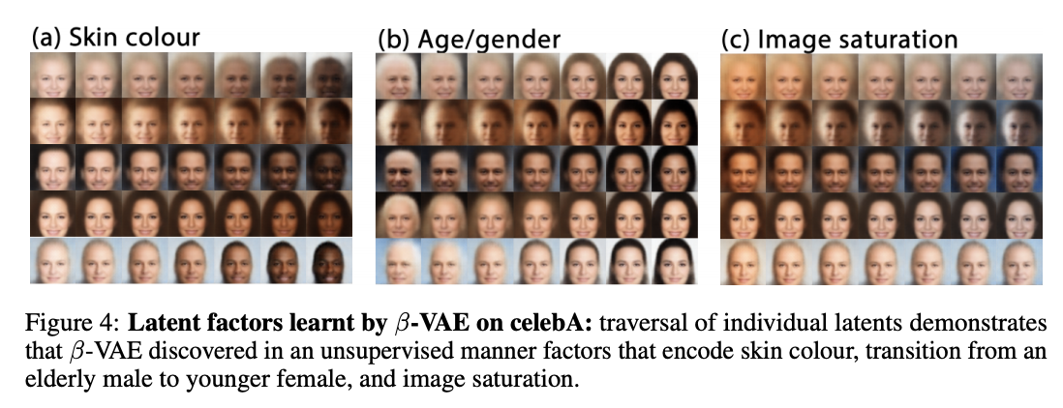
Beta VAE
Beta-VAE is a type of variational autoencoder that seeks to discovered disentangled latent factors. It modifies VAEs with an adjustable hyperparameter that balances latent channel capacity and independence constraints with reconstruction accuracy.

Slide 23
Beta VAE
In β-VAE, a factor β is introduced.
A higher value of β puts more emphasis on the statistical independence than on the reconstruction.
As it has been observed in experiments, this stronger focus on statistical independence helps a lot in making the latent code more interpretable.
However, as focusing on statistical independence automatically means to care less about good reconstructions, we have to pay for the increased interpretablity with reduced reconstruction quality.

